Slide 1
SWINGS

Slide 2
Swing is a set of classes that provides more powerful and flexible components than are possible with the AWT
Unlike AWT components, Swing components are not implemented by platform-specific code
Instead, they are written entirely in Java and, therefore, are platform-independent
The Swing-related classes are contained in javax.swing and its subpackages, such as javax.swing.tree

Slide 3
JApplet
Fundamental to Swing is the JApplet class, which extends Applet
Applets that use Swing must be subclasses of JApplet
JApplet is rich with functionality that is not found in Applet

Slide 4
Icons and Labels
In Swing, icons are encapsulated by the ImageIcon class, which paints an icon from an image
Two of its constructors are shown here:
ImageIcon(String filename)
ImageIcon(URL url)

Slide 5
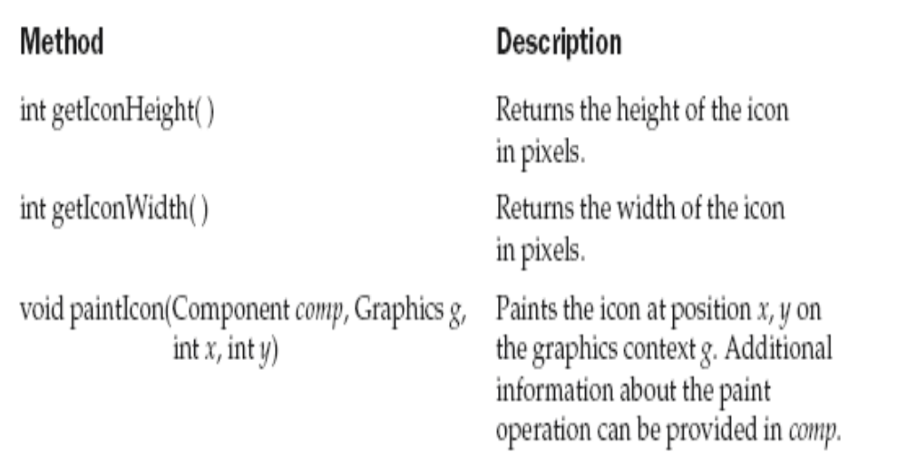
The ImageIcon class implements the Icon interface that declares the methods shown here:

Slide 6
Swing labels are instances of the JLabel class
It can display text and/or an icon
JLabel(Icon i)
Label(String s)
JLabel(String s, Icon i, int align)
Here, s and i are the text and icon used for the label
The align argument is either LEFT, RIGHT, CENTER, LEADING, or TRAILING

Slide 7
The icon and text associated with the label can be read and written by the following methods:
Icon getIcon( )
String getText( )
void setIcon(Icon i)
void setText(String s)
Here, i and s are the icon and text, respectively

Slide 8
JLabelDemo.java
import java.awt.*;
import javax.swing.*;
/*<applet code="JLabelDemo" width=250 height=150></applet>*/
public class JLabelDemo extends JApplet {
public void init() {
// Get content pane
Container contentPane = getContentPane();
// Create an icon
ImageIcon ii = new ImageIcon("france.gif");
// Create a label
JLabel jl = new JLabel("France", ii, JLabel.CENTER);
// Add label to the content pane
contentPane.add(jl);
}
}

Slide 9
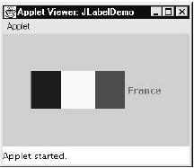

Slide 10
Text Fields
The Swing text field is encapsulated by the JTextComponent class, which extends JComponent
JTextField allows you to edit one line of text
JTextField( )
JTextField(int cols)
JTextField(String s, int cols)
JTextField(String s)
Here, s is the string to be presented, and cols is the number of columns in the text field

Slide 11
import java.awt.*;
import javax.swing.*;
/*
<applet code="JTextFieldDemo" width=300 height=50></applet>*/
public class JTextFieldDemo extends JApplet {
JTextField jtf;
public void init() {
// Get content pane
Container contentPane = getContentPane();
contentPane.setLayout(new FlowLayout());
// Add text field to content pane
jtf = new JTextField(15);
contentPane.add(jtf);
}
}

Slide 12
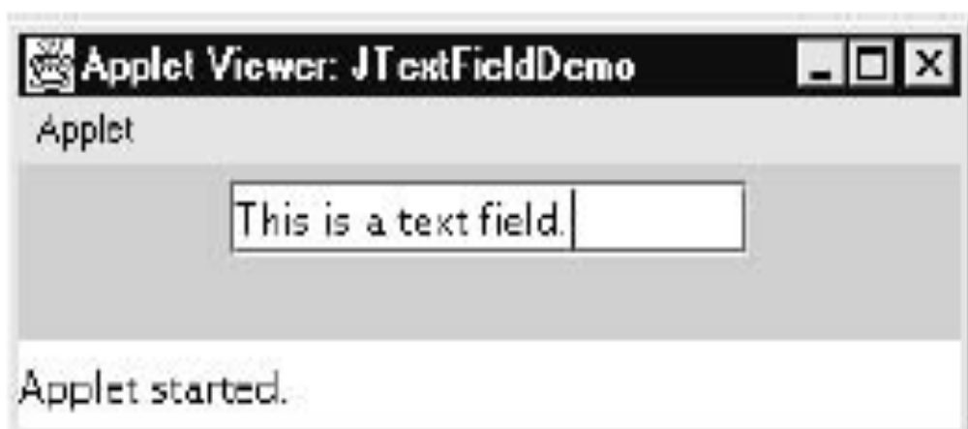

Slide 13
Buttons – The JButton Class
The JButton class provides the functionality of a push button
JButton allows an icon, a string, or both to be associated with the push button
JButton(Icon i)
JButton(String s)
JButton(String s, Icon i)
Here, s and i are the string and icon used for the button

Slide 14
import java.awt.*;
import java.awt.event.*;
import javax.swing.*;
/*
<applet code="JButtonDemo" width=250 height=300>
</applet>
*/
public class JButtonDemo extends JApplet
implements ActionListener {
JTextField jtf;
public void init() {
// Get content pane
Container contentPane = getContentPane();
contentPane.setLayout(new FlowLayout());
// Add buttons to content pane
ImageIcon france = new ImageIcon("france.gif");
JButton jb = new JButton(france);
jb.setActionCommand("France");
jb.addActionListener(this);
contentPane.add(jb);

Slide 15
ImageIcon germany = new ImageIcon("germany.gif");
jb = new JButton(germany);
jb.setActionCommand("Germany");
jb.addActionListener(this);
contentPane.add(jb);
ImageIcon italy = new ImageIcon("italy.gif");
jb = new JButton(italy);
jb.setActionCommand("Italy");
jb.addActionListener(this);
contentPane.add(jb);
ImageIcon japan = new ImageIcon("japan.gif");
jb = new JButton(japan);
jb.setActionCommand("Japan");
jb.addActionListener(this);
contentPane.add(jb);
// Add text field to content pane
jtf = new JTextField(15);
contentPane.add(jtf);
}
public void actionPerformed(ActionEvent ae) {
jtf.setText(ae.getActionCommand());
}
}

Slide 16
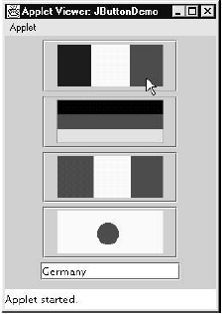

Slide 17
Check Boxes
JCheckBox(Icon i, boolean state)
JCheckBox(String s)
JCheckBox(String s, boolean state)
JCheckBox(String s, Icon i)
JCheckBox(String s, Icon i, boolean state)
Here, i is the icon for the button. The text is specified by s. If state is true, the check box
is initially selected. Otherwise, it is not

Slide 18
The state of the check box can be changed via the following method:
void setSelected(boolean state)
Here, state is true if the check box should be checked
When a check box is selected or deselected, an item event is generated. This is handled by itemStateChanged( )

Slide 19
Inside itemStateChanged( ), the getItem( ) method gets the JCheckBox object that generated the event
The getText( ) method gets the text for that check box and uses it to set the text inside the text field

Slide 20
import java.awt.*;
import java.awt.event.*;
import javax.swing.*;
/*
<applet code="JCheckBoxDemo" width=400 height=50>
</applet>
*/
public class JCheckBoxDemo extends JApplet
implements ItemListener {
JTextField jtf;
public void init() {
// Get content pane
Container contentPane = getContentPane();
contentPane.setLayout(new FlowLayout());
// Create icons
ImageIcon normal = new ImageIcon("normal.gif");
ImageIcon rollover = new ImageIcon("rollover.gif");
ImageIcon selected = new ImageIcon("selected.gif");

Slide 21
// Add check boxes to the content pane
JCheckBox cb = new JCheckBox("C", normal);
cb.setRolloverIcon(rollover);
cb.setSelectedIcon(selected);
cb.addItemListener(this);
contentPane.add(cb);
cb = new JCheckBox("C++", normal);
cb.setRolloverIcon(rollover);
cb.setSelectedIcon(selected);
cb.addItemListener(this);
contentPane.add(cb);
cb = new JCheckBox("Java", normal);
cb.setRolloverIcon(rollover);
cb.setSelectedIcon(selected);
cb.addItemListener(this);
contentPane.add(cb);
cb = new JCheckBox("Perl", normal);
cb.setRolloverIcon(rollover);
cb.setSelectedIcon(selected);
cb.addItemListener(this);
contentPane.add(cb);

Slide 22
// Add text field to the content pane
jtf = new JTextField(15);
contentPane.add(jtf);
}
public void itemStateChanged(ItemEvent ie) {
JCheckBox cb = (JCheckBox)ie.getItem();
jtf.setText(cb.getText());
}
}

Slide 23
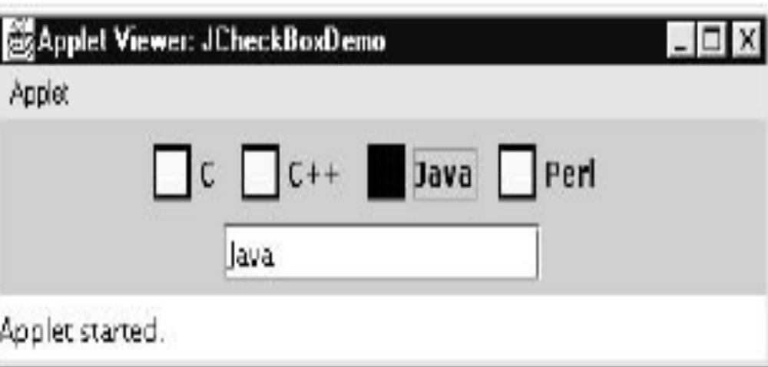

Slide 24
Radio Buttons
Radio buttons are supported by the JRadioButton class
JRadioButton(Icon i)
JRadioButton(Icon i, boolean state)
JRadioButton(String s)
JRadioButton(String s, boolean state)
JRadioButton(String s, Icon i)
JRadioButton(String s, Icon i, boolean state)
Here, i is the icon for the button. The text is specified by s. If state is true, the button is initially selected. Otherwise, it is not

Slide 25
Radio buttons must be configured into a group. Only one of the buttons in that group can be selected at any time
The ButtonGroup class is instantiated to create a button group
Its default constructor is invoked for this purpose
Elements are then added to the button group via the following method:
void add(AbstractButton ab)
Here, ab is a reference to the button to be added to the group

Slide 26
Radio button presses generate action events that are handled by actionPerformed( )
The getActionCommand( ) method gets the text that is associated with a radio button and uses it to set the text field

Slide 27
import java.awt.*;
import java.awt.event.*;
import javax.swing.*;
/*
<applet code="JRadioButtonDemo" width=300 height=50></applet>*/
public class JRadioButtonDemo extends JApplet
implements ActionListener {
JTextField tf;
public void init() {
// Get content pane
Container contentPane = getContentPane();
contentPane.setLayout(new FlowLayout());
// Add radio buttons to content pane
JRadioButton b1 = new JRadioButton("A");
b1.addActionListener(this);
contentPane.add(b1);
JRadioButton b2 = new JRadioButton("B");
b2.addActionListener(this);
contentPane.add(b2);

Slide 28
JRadioButton b3 = new JRadioButton("C");
b3.addActionListener(this);
contentPane.add(b3);
// Define a button group
ButtonGroup bg = new ButtonGroup();
bg.add(b1);
bg.add(b2);
bg.add(b3);
// Create a text field and add it
// to the content pane
tf = new JTextField(5);
contentPane.add(tf);
}

Slide 29
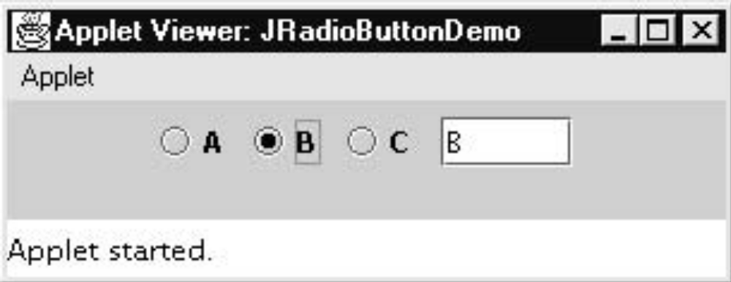
public void actionPerformed(ActionEvent ae) {
tf.setText(ae.getActionCommand());
}
}

Slide 30
Combo Boxes
Swing provides a combo box (a combination of a text field and a drop-down list) through the JComboBox class
JComboBox( )
JComboBox(Vector v)
Here, v is a vector that initializes the combo box

Slide 31
Items are added to the list of choices via the addItem( ) method, whose signature is shown here:
void addItem(Object obj)
Here, obj is the object to be added to the combo box

Slide 32
import java.awt.*;
import javax.swing.*;
/*<applet code="JComboBoxDemo" width=300 height=100></applet>*/
public class JComboBoxDemo extends JApplet
implements ItemListener {
JLabel jl;
ImageIcon france, germany, italy, japan;
public void init() {
// Get content pane
Container contentPane = getContentPane();
contentPane.setLayout(new FlowLayout());
// Create a combo box and add it
// to the panel
JComboBox jc = new JComboBox();
jc.addItem("France");
jc.addItem("Germany");
jc.addItem("Italy");
jc.addItem("Japan");
jc.addItemListener(this);
contentPane.add(jc);

Slide 33
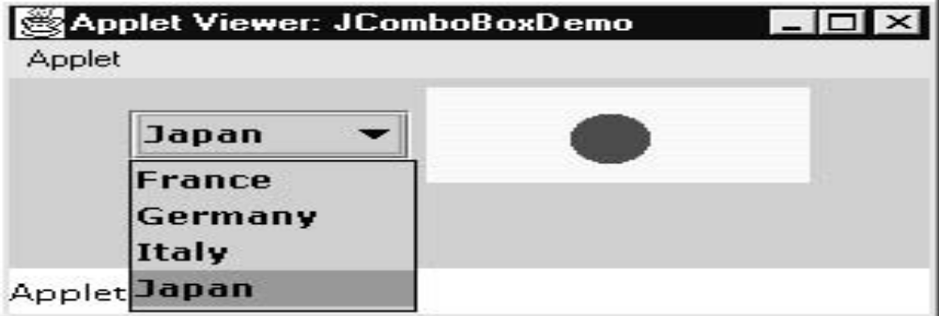
// Create label
jl = new JLabel(new ImageIcon("france.gif"));
contentPane.add(jl);
}
public void itemStateChanged(ItemEvent ie) {
String s = (String)ie.getItem();
jl.setIcon(new ImageIcon(s + ".gif"));
}
}

Slide 34
Tabbed Panes
A tabbed pane is a component that appears as a group of folders in a file cabinet
Each folder has a title
When a user selects a folder, its contents become visible
Only one of the folders may be selected at a time

Slide 35
Tabbed panes are encapsulated by the JTabbedPane class
Tabs are defined via the following method:
void addTab(String str, Component comp)
Here, str is the title for the tab, and comp is the component that should be added to the tab
Typically, a JPanel or a subclass of it is added

Slide 36
The general procedure to use a tabbed pane in
an applet is outlined here
1. Create a JTabbedPane object
2. Call addTab( ) to add a tab to the pane. (The arguments to this method define the title of the tab and the component it contains)
3. Repeat step 2 for each tab
4. Add the tabbed pane to the content pane of the applet

Slide 37
import javax.swing.*;
/*
<applet code="JTabbedPaneDemo" width=400 height=100>
</applet>
*/
public class JTabbedPaneDemo extends JApplet {
public void init() {
JTabbedPane jtp = new JTabbedPane();
jtp.addTab("Cities", new CitiesPanel());
jtp.addTab("Colors", new ColorsPanel());
jtp.addTab("Flavors", new FlavorsPanel());
getContentPane().add(jtp);
}
}

Slide 38
class CitiesPanel extends JPanel {
public CitiesPanel() {
JButton b1 = new JButton("New York");
add(b1);
JButton b2 = new JButton("London");
add(b2);
JButton b3 = new JButton("Hong Kong");
add(b3);
JButton b4 = new JButton("Tokyo");
add(b4);
}
}

Slide 39
class ColorsPanel extends JPanel {
public ColorsPanel() {
JCheckBox cb1 = new JCheckBox("Red");
add(cb1);
JCheckBox cb2 = new JCheckBox("Green");
add(cb2);
JCheckBox cb3 = new JCheckBox("Blue");
add(cb3);
}
}
class FlavorsPanel extends JPanel {
public FlavorsPanel() {
JComboBox jcb = new JComboBox();
jcb.addItem("Vanilla");
jcb.addItem("Chocolate");
jcb.addItem("Strawberry");
add(jcb);
}
}

Slide 40
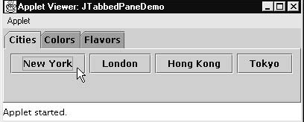
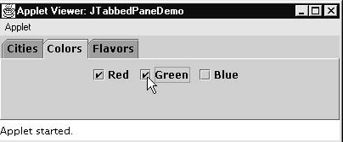

Slide 41
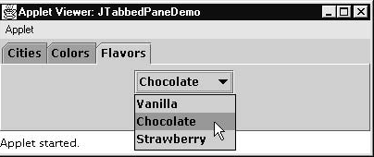

Slide 42
Scroll Panes
A scroll pane is a component that presents a rectangular area in which a component may be viewed
Horizontal and/or vertical scroll bars may be provided if necessary
Scroll panes are implemented in Swing by the JScrollPane class

Slide 43
JScrollPane(Component comp)
JScrollPane(int vsb, int hsb)
JScrollPane(Component comp, int vsb, int hsb)
Here, comp is the component to be added to the scroll pane. vsb and hsb are int constants that define when vertical and horizontal scroll bars for this scroll pane are shown

Slide 44
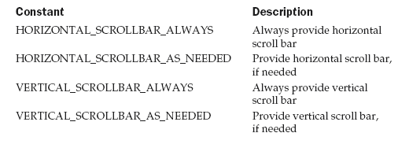

Slide 45
import java.awt.*;
import javax.swing.*;
/* <applet code="JScrollPaneDemo" width=300 height=250>
</applet>*/
public class JScrollPaneDemo extends JApplet {
public void init() {
// Get content pane
Container contentPane = getContentPane();
contentPane.setLayout(new BorderLayout());
// Add 400 buttons to a panel
JPanel jp = new JPanel();
jp.setLayout(new GridLayout(20, 20));
int b = 0;
for(int i = 0; i < 20; i++) {
for(int j = 0; j < 20; j++) {
jp.add(new JButton("Button " + b));
++b;
}
}

Slide 46
// Add panel to a scroll pane
int v = ScrollPaneConstants.VERTICAL_SCROLLBAR_AS_NEEDED;
int h = ScrollPaneConstants.HORIZONTAL_SCROLLBAR_AS_NEEDED;
JScrollPane jsp = new JScrollPane(jp, v, h);
// Add scroll pane to the content pane
contentPane.add(jsp, BorderLayout.CENTER);
}
}

Slide 47
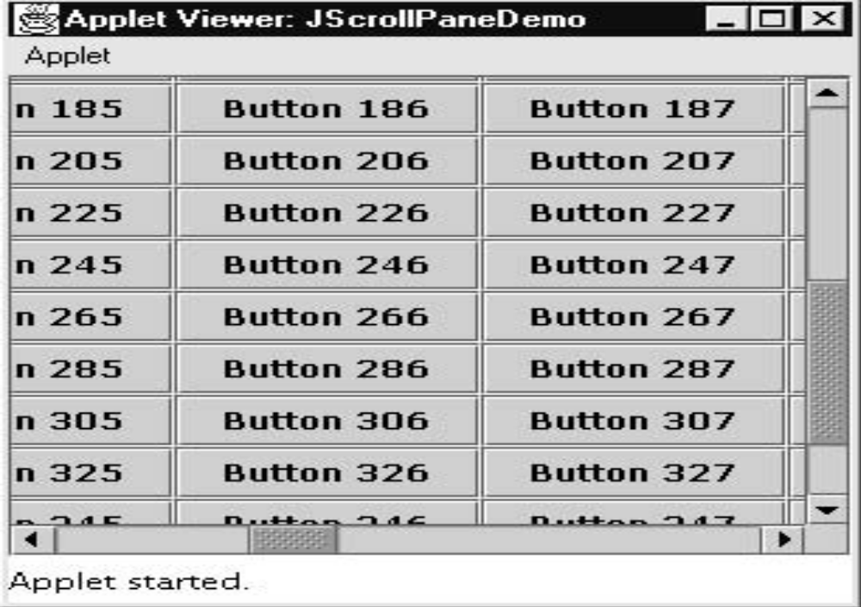

Slide 48
Table
A table is a component that displays rows and columns of data
Tables are implemented by the JTable class

Slide 49
JTable(Object data[ ][ ], Object colHeads[ ])
data is a two-dimensional array of the information to be presented
colHeads is a one-dimensional array with the column headings

Slide 50
Here are the steps for using a table in an
applet:
1. Create a JTable object
2. Create a JScrollPane object. (The arguments to the
constructor specify the table and the policies for
vertical and horizontal scroll bars.)
3. Add the table to the scroll pane
4.Add the scroll pane to the content pane of the applet.

Slide 51
import java.awt.*;
import javax.swing.*;
/*
<applet code="JTableDemo" width=400 height=200>
</applet>
*/
public class JTableDemo extends JApplet {
public void init() {
// Get content pane
Container contentPane = getContentPane();
// Set layout manager
contentPane.setLayout(new BorderLayout());
// Initialize column headings
final String[] colHeads = { "Name", "Phone", "Fax" };

Slide 52
// Initialize data
final Object[][] data = {
{ "Gail", "4567", "8675" },
{ "Ken", "7566", "5555" },
{ "Viviane", "5634", "5887" },
{ "Melanie", "7345", "9222" },
{ "Anne", "1237", "3333" },
{ "John", "5656", "3144" },
{ "Matt", "5672", "2176" },
{ "Claire", "6741", "4244" },
{ "Erwin", "9023", "5159" },
{ "Ellen", "1134", "5332" },
{ "Jennifer", "5689", "1212" },
{ "Ed", "9030", "1313" },
{ "Helen", "6751", "1415" }
};
// Create the table
JTable table = new JTable(data, colHeads);
// Add table to a scroll pane
int v = ScrollPaneConstants.VERTICAL_SCROLLBAR_AS_NEEDED;
int h = ScrollPaneConstants.HORIZONTAL_SCROLLBAR_AS_NEEDED;
JScrollPane jsp = new JScrollPane(table, v, h);
// Add scroll pane to the content pane
contentPane.add(jsp, BorderLayout.CENTER);
}
}

Slide 53
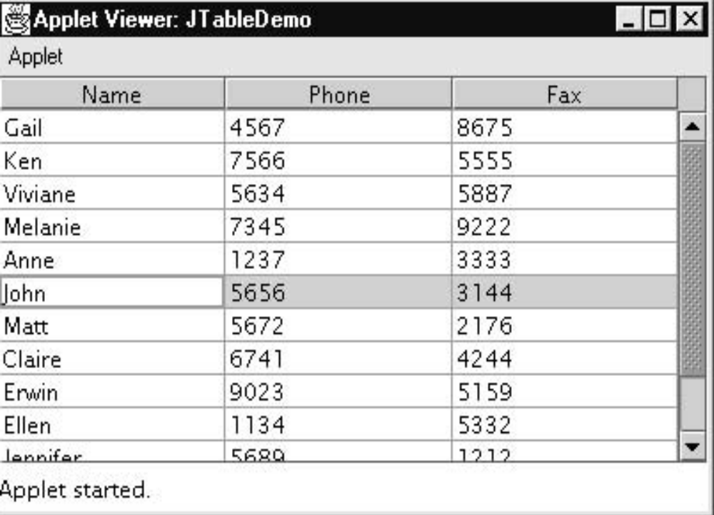

Slide 54
End of Unit - 4

